Slide 1

What’s Cooking?
Cathy Webster, Kathryn Lovett, Christopher Henderson

Slide 2
Proposal
We took on the Kaggle challenge for “What’s Cooking?”
From the challenge page:
Picture yourself strolling through your local, open-air market... What do you see? What do you smell? What will you make for dinner tonight?
If you're in Northern California, you'll be walking past the inevitable bushels of leafy greens, spiked with dark purple kale and the bright pinks and yellows of chard. Across the world in South Korea, mounds of bright red kimchi greet you, while the smell of the sea draws your attention to squids squirming nearby. India’s market is perhaps the most colorful, awash in the rich hues and aromas of dozens of spices: turmeric, star anise, poppy seeds, and garam masala as far as the eye can see.
Some of our strongest geographic and cultural associations are tied to a region's local foods. This playground competitions asks you to predict the category of a dish's cuisine given a list of its ingredients.

Slide 3
Data
The challenge provided training and test data in JSON form.
Training Data
39,774 Individual Recipes
20 Categories
6714 Feature
Testing data
Contained approximately 20% the size of the training data
Challenging elements
The 6714 individual features combined with 20 categories to associate them to.

Slide 4
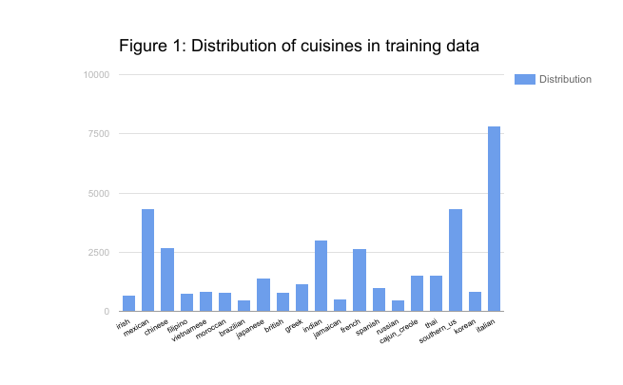
Sample Data
Sample Data
"id": 10259,
”cuisine": "greek",
"ingredients": [
"romaine lettuce",
"black olives",
"grape tomatoes",
"garlic",
"pepper",
"purple onion",
"seasoning",
"garbanzo beans",
"feta cheese crumbles”]

Slide 5
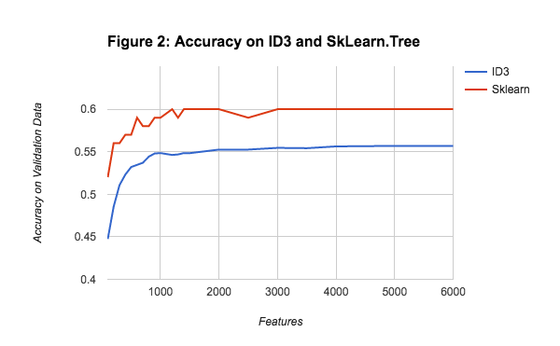
Decision Tree
We repurposed the original ID3 from the first programming assignment and ran the training and testing JSON.
We also used the SkLearning.Tree from http://scikit-learn.org
As you can see the provided code by SkLearning produces better results.

Slide 6
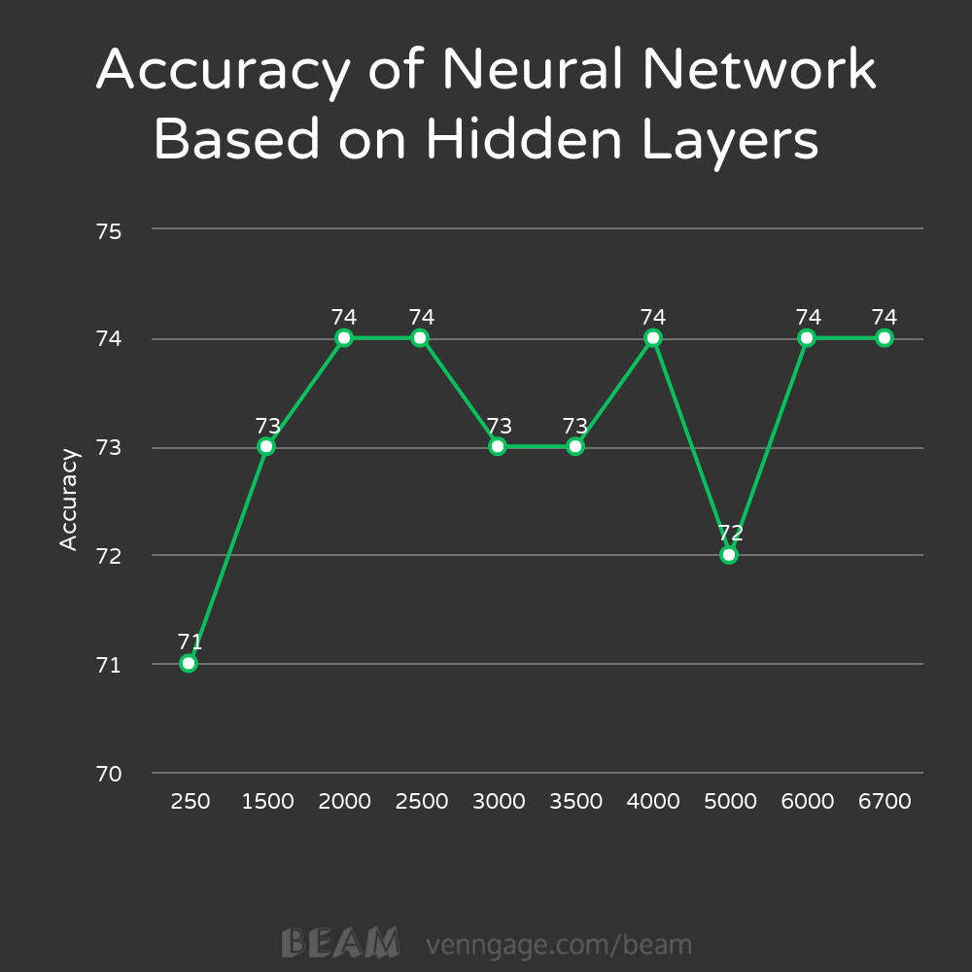
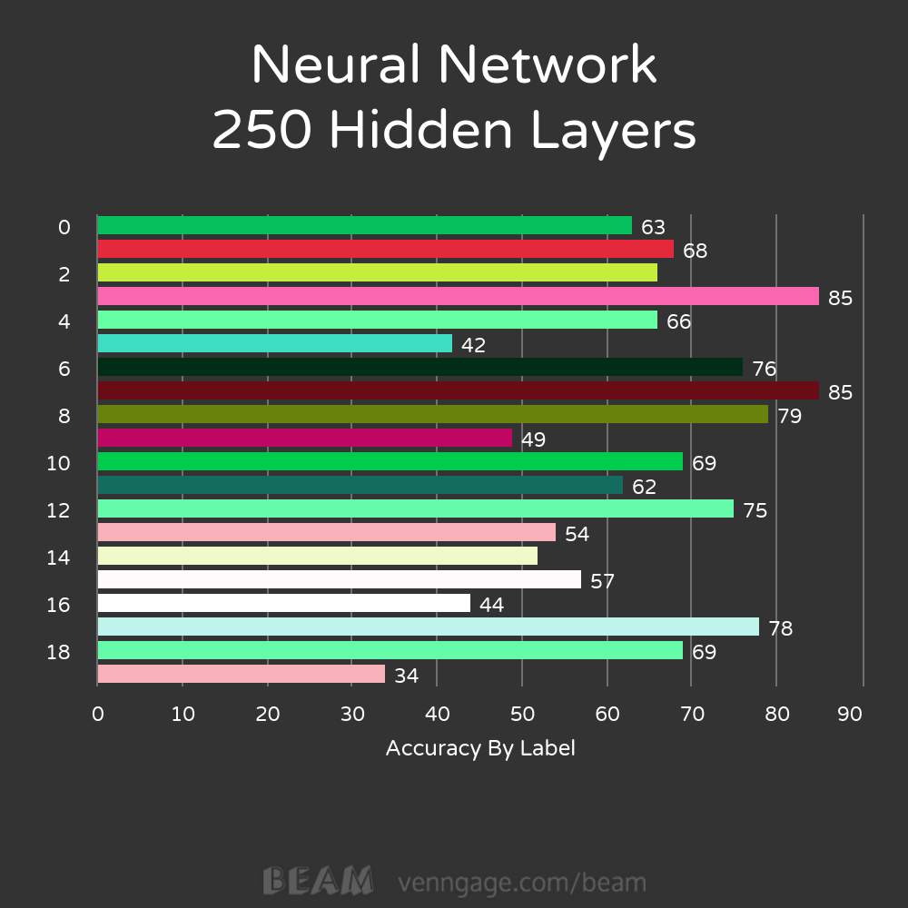
Neural Network

Slide 7
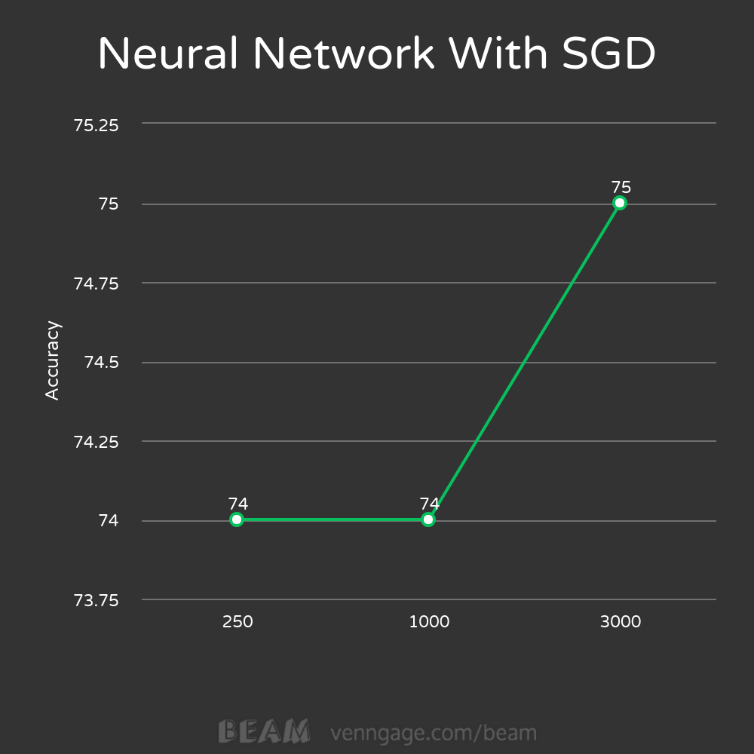
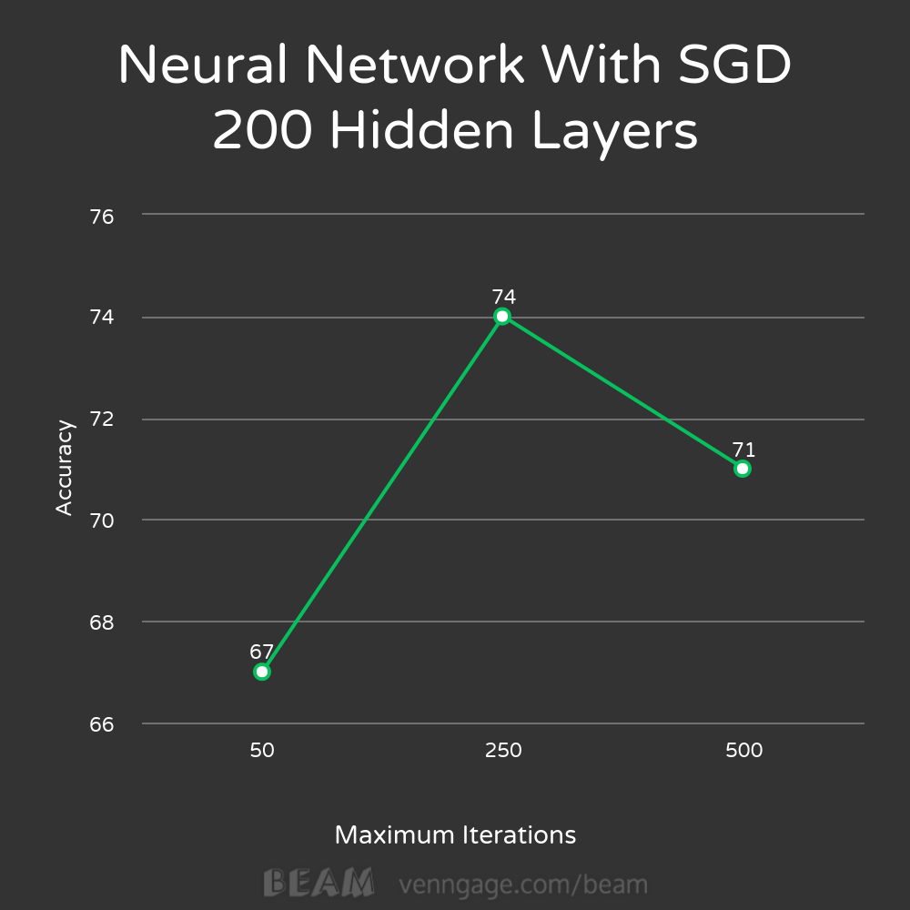
Neural Network (Cont. SGD)

Slide 8
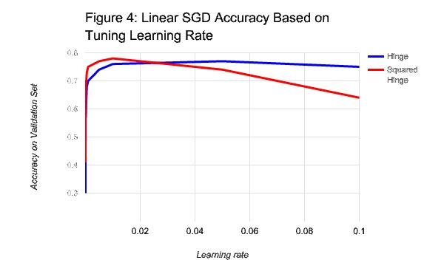
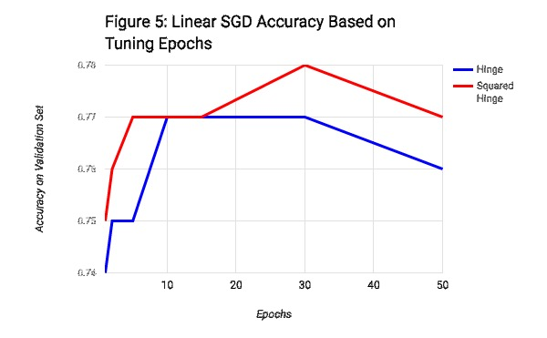
Linear SGD
Test

Slide 9
Conclusion
We tried a variety of different techniques.
Decision tree – Are not optimal in multiclass and the number of features that was in our data set.
Neural Networks – Provided a excellent model but hidden layer count and iterations did not always provide optimal information. But with optimizations like SGD it can produce increased accuracy.
Linear SGD - It did not provide a exceptional increase though
We decided on Linear SGD as it provided the highest accuracy.
We determined that 200 -250 iterations appeared to be optimal
Like in all things, sometimes you have to try it all to find what works best.

Slide 10
Questions?

Slide 11
References
https://www.kaggle.com/c/whats-cooking
http://scikit-learn.org/stable/modules/neural_networks_supervised.html

